Slide 1
ABM: Vitoria-Gasteiz
Amparo Alonso Betanzos
Bertha Guijarro Berdiñas
Alejandro Rodríguez Arias
Noelia Sánchez Maroño

Slide 2
Phase 1: Hypothesis
To understand citizen acceptance of certain social innovations in order to study their upscaling and replicability ...
Which percentage of citizens will be in favor and which against superblocks in specific policy scenarios?

Slide 3
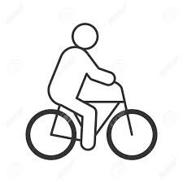
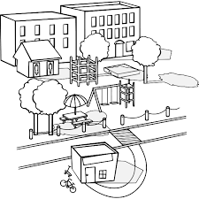
Phase 2: Agents
☑
☒
Local Media (Press)
Council
☑
Citizens
Several associations
Merchants Associations

Slide 4
Phase 3: social networks
FRIENDS
NEIGHBOORS

Slide 5
Phase 4: HUMAT model
Behavior of citizens
ENVIRONMENTAL
QUALITY
☒
Against superblocks
☑
☒
☑
☑
In favor of superblocks
COMFORT
PARTICIPATION
?
Undecided about superblocks
Citizens
SOCIAL
PRESTIGE

Slide 6
Phase 4: Citizens´ Behavior
Directed links establish relations between two citizens.
Links' weights represent the trust of the citizens in that relation
0,6
0,9
0,8
0,3
0,6
0,6
ENVIROMENTAL
QUALITY
ENVIRONMENTAL
QUALITY
COMFORT
PARTICIPATION
?
COMFORT
PARTICIPATION
PRESTIGE
PRESTIGE

Slide 7
Phase 4 : Behavior of critical nodes
Relation between a critical node and a citizen is carried out by an unidirectional link
Critical nodes only communicate with citizens
(not with other critical nodes)
Their function in the model is to try to influence the citizens
0,8
0,5
0,6
0,3

Slide 8
Phase 5: From the questionnaire to the model
Interpretation of questions from questionnaire to HUMAT model architecture
Questionnaire | Related need
Q16_2. Degree of importance. Quality of air in Vitoria-Gasteiz. | Environmental quality-Importance
Q18_5. Degree of importance. To be involved in decisions that affect the city | Participation-Importance
Q17_6. Degree of concern. Not having enough parking places in the superblocks | Comfort-Importance

Slide 9
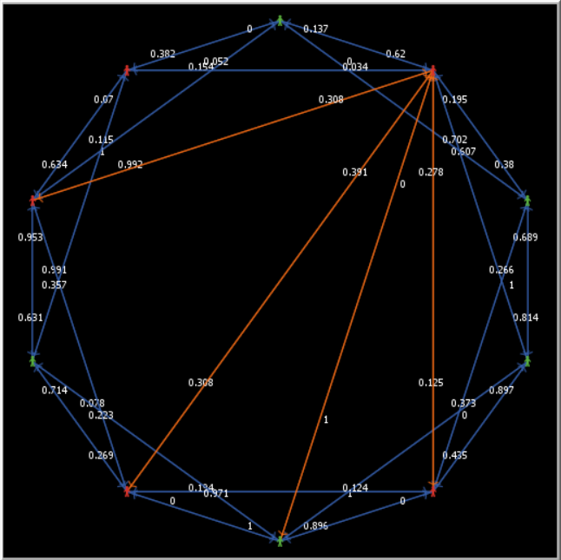
Phase 5: From the questionnaire to the model
Social Network
Size of the network
Trust in the relations

Slide 10
Phase 5: From the questionnaire to the model
Representing the population
"Real" citizens
865 complete questionnaires
1:1 each questionnaire models an agent
Population profiles are created
☑
☒
☑
Citizens

Slide 11
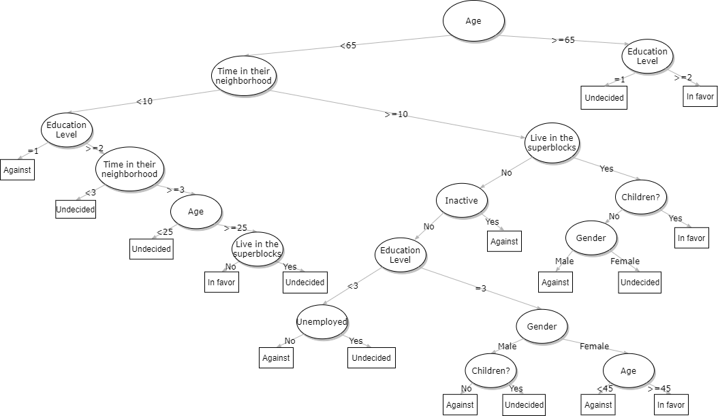
Phase 5: From the questionnaire to the model
Representing the population
"Artificial citizens"
Vitoria-Gasteiz census data
Population profiles obtained from real data

Slide 12
Phase 6: reproducing the process
Critical node | Trigger | Tactic | Duration | Frequency | Orientation | Audience | Coverage | Opinion
Neighboorhood Associations | 09/2009 | Establishing a critic position through the local press | 2 months | 1 per month | Comfort | Medium | Yes (2 news) | Against
Primary critical node | Opinion | Starting date | Ending date | Frequency | Extent | Secondary critical node | Focus
Other Associations | Against | 09/2009 | 10/2009 | 1 | 0.2 | Local Press | Comfort

Slide 13
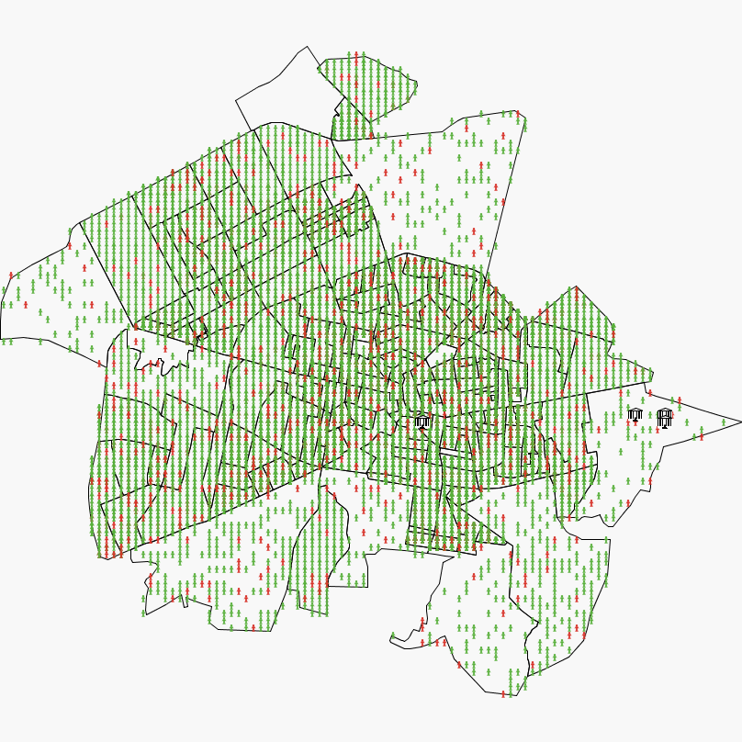
Fase 6: Reproducing the process
Representation of Vitoria-Gasteiz (map)
Representing the citizens
Green: In favor of superblocks
Red: Against superblocks

Slide 14
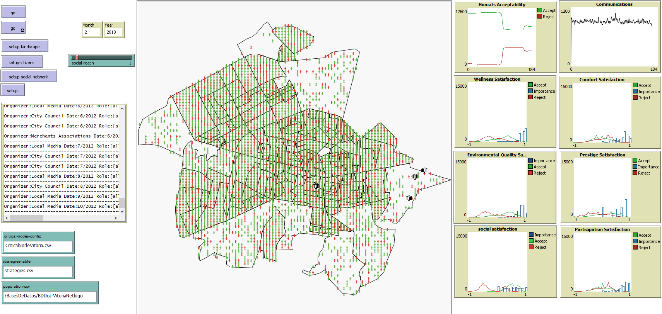
Fase 6: Recreación del proceso
Estrategias de los nodos críticos

Slide 15
Alternative Scenario Nº1
Scenario 1a:
18 new communications from the City Council to citizens addressing the satisfaction of the need for comfort (january 2007-june 2010)
8 new communications from supporters and 6 new communications from local media (in 2007 and 2009) endorsing the campaign
Notes:
Description of the alternative scenario: Modification in the strategy of the critical nodes: a new communication campaign would be conducted in the first stages of the project for citizens to become more familiar with superblocks and anticipate resident’s contestation
Implementation of a new communication strategy since the early stages of the project
Scenario 1:
Introducing 18 new communications from the City Council to citizens addressing the satisfaction of the need for comfort. in order to anticipate the discontent of the residents that, for example, perceive that the policy restricts their “right” to park in their street for free.
Evento – Modificación de la confianza en la prensa local y las asociaciones
Duración: 1/2009-6/2010
Si la importancia del confort para el humat está entre 0.4 y 0.6 se reduce la confianza en la prensa y las asociaciones en un 20%.
Si la importancia del confort para el humat es superior al 0.8 se aumenta la confianza en la prensa y las asociaciones en un 20%.

Slide 16
Alternative Scenario Nº1
Scenario 1b (meetings):
Reproduces the communication strategy described in Scenario 1a
Introduces citizen's meetings that happened in three specific stages:
July 2006 (starting out of the project): Meetings in all census sections of the city
June 2009 (new parking policy in central superblocks). Meetings in specific census sections that are affected by the increase in the price of outdoor parking.
January 2012. Meetings in all census sections of the city.

Slide 17
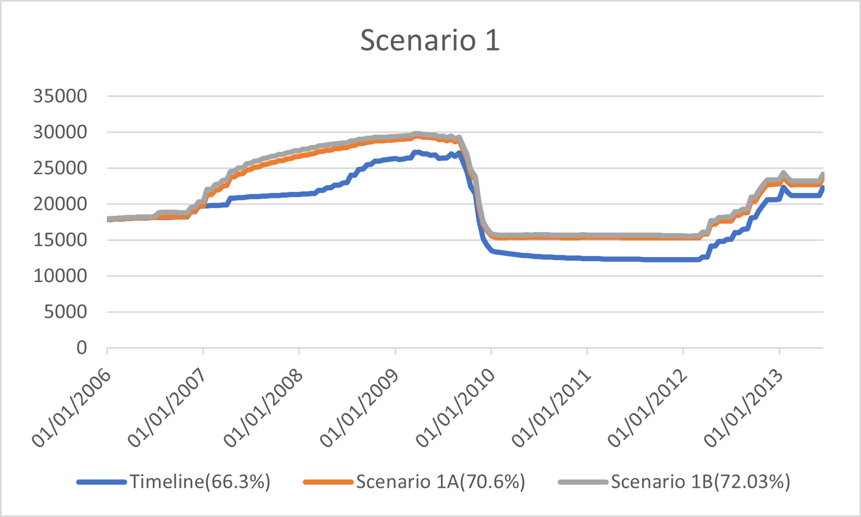
Alternative Scenario Nº1 Results
Notes:
The main lesson to draw from the model concerns the efficacy of designing specific campaigns addressing the need for comfort. Anticipating contestation by starting the communications two years earlier is also very effective. The results also stress the importance of increasing the scope of the campaigns to reach a large number of inhabitants. Involving both local media and local associations (e.g., cyclists associations) who endorse the key messages, raises to 70,6% the levels of public acceptability towards superblocks (since only 66.3% of the population voted in favour of the SI in the real scenario).
As scenario 1b shows, involving citizens in random communications is more effective than only launching a communication strategy. Spontaneous conversations about superblocks in three relevant periods of the project increase up to 5,73% the rate of people voting in favour of the measure.

Slide 18
Alternative Scenario Nº2
If people have spaces to communicate among them and discuss the new policy, would the acceptability of the superblocks project improve?
Scenario 2 introduces citizen's meetings that happen in the same stages as in scenario 1b.
Scenario 2b: We add 6 new communications from the local media (supporting the policy).
Scenario 2c: We add 6 new communications from the local associations (supporting the policy).

Slide 19
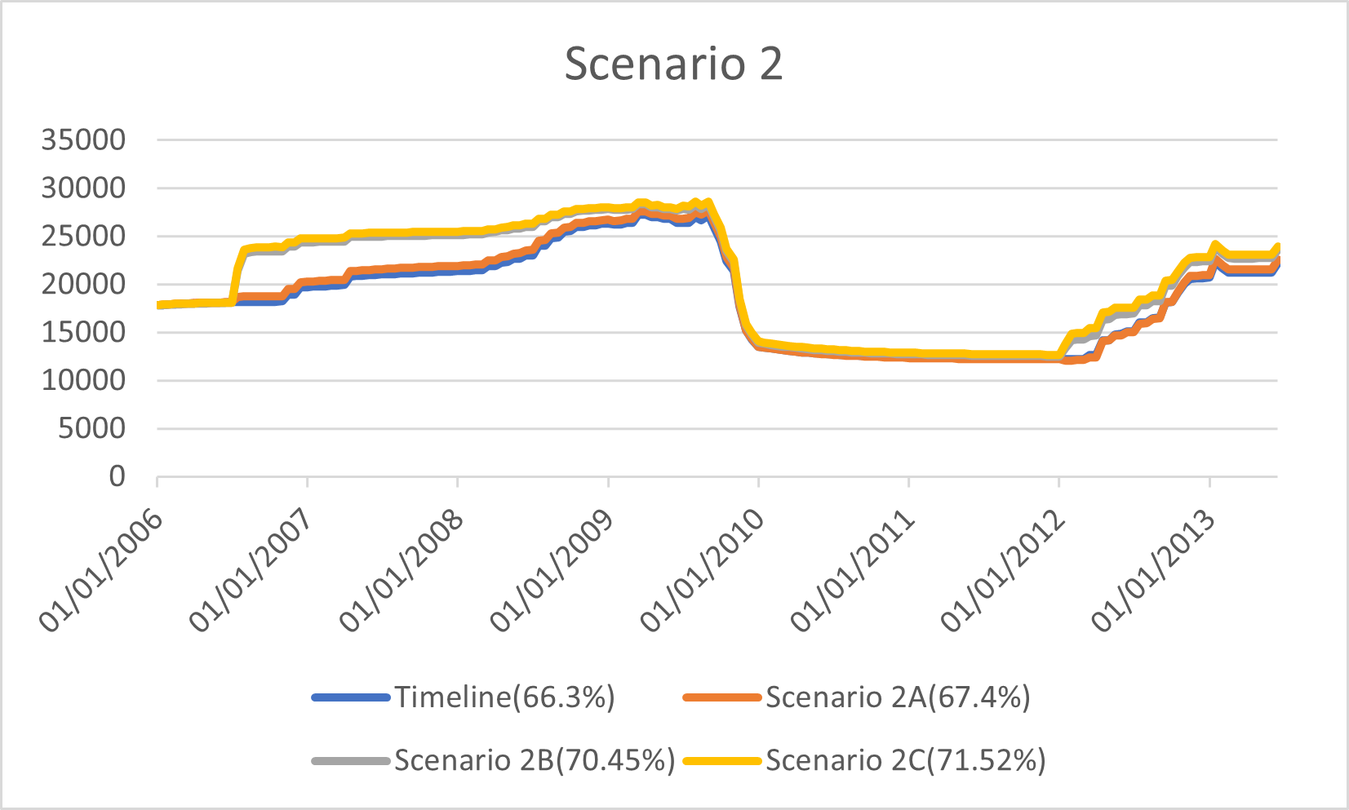
Alternative Scenario Nº2 Results
Notes:
Timeline (66.3%)
Scenario 2 mejora 1.1% (67.4%)
Scenario 2B sube al 70.45%
Scenario 2C sube al 71.52%

Slide 20
Alternative Scenario Nº3
Scenario 3 combines two different strategies:
Environmental awarenesses campaign led by the City Council from January 2007 to June 2010, involving 42 communications in 3 years and a half (one per month).
Self-organized meetings between residents in the same census sections. These meetings take place on the same dates as in scenario 1b.
Notes:
This alternative scenario consists of the development of an environmental education policy aiming at increasing residents’ concern towards wellbeing and environmental quality. Two different combinations of strategies have been implemented in the model. First, scenario 3a combines an environmental awarenesses campaign with the organization of meetings in census sections to foster citizen’s communications about the campaign. Second, scenario 3b involves also the press and local associations supporting the policy.

Slide 21
Alternative Scenario Nº3
Scenario 3b
Reproduces the communication strategy described in Scenario 3
Adds new communications from local actors supporting the environmental education campaign:
6 new communications from the local media
6 new communications from the local associations

Slide 22
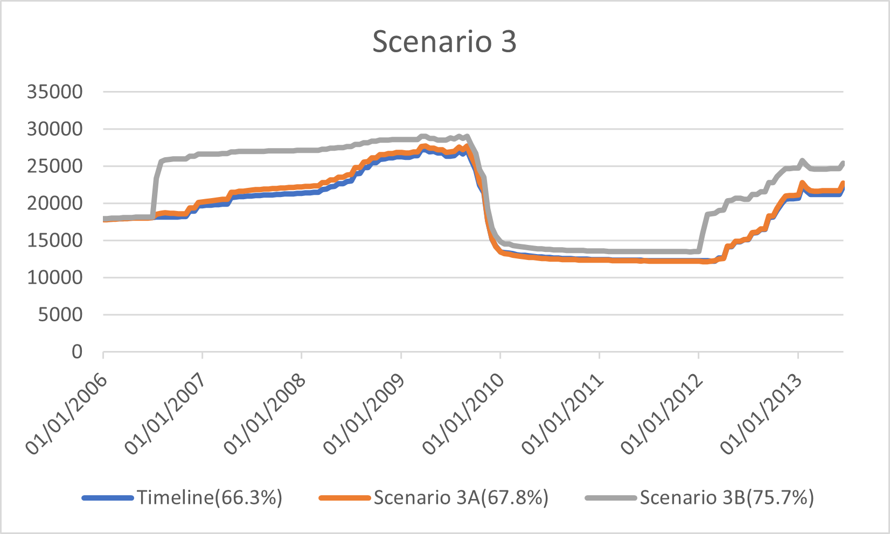
Alternative Scenario Nº3 Results
Notes:
Scenario 3 represents the effect of citizen participatory actions (organized as meetings among residents at census section level) in combination with an environmental awareness campaign. In scenario 3a, the level of social acceptability of superblocks reaches only up to 67.8% (↑1,5%). Scenario 3b becomes the most promising scenario as the rate of support towards the SI rises 9 points (↑9,41) in comparison to the base scenario, as a result of the combination between participatory approaches and awareness-raising strategies led by several actors: the city council and the local associations and supported by the local media.

Slide 23
Thanks!

